Slide 1
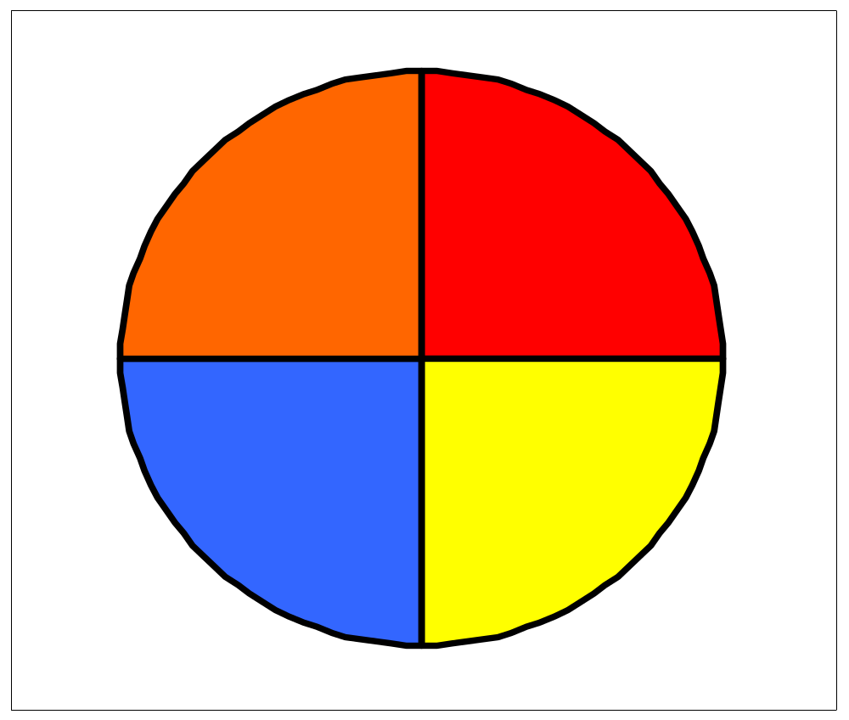
HD5

Slide 2
SAMPLE KEY QUESTIONS
HD5
SUPPORT
CORE
EXTENSION
In my survey there were 8 pupils altogether. How many are shown by the red slice of the pie? The yellow slice?
The blue slice shows 4 people. How many were in my survey altogether?
The red slice represents 3 students. How many …….

Slide 3
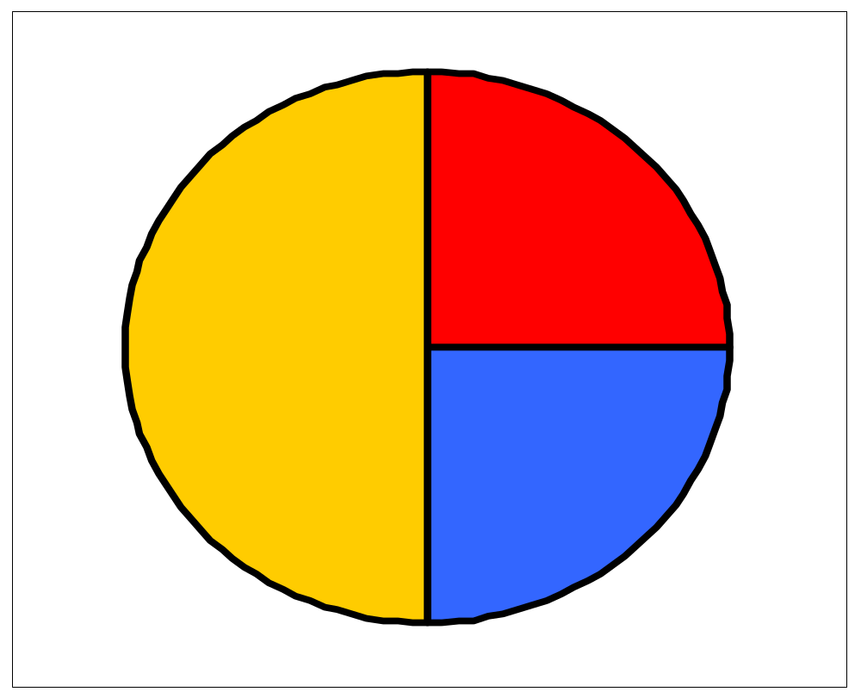
HD6

Slide 4
SAMPLE KEY QUESTIONS
HD6
SUPPORT
CORE
EXTENSION
In my survey there were 8 pupils altogether. How many are shown by the red slice of the pie? The yellow slice?
The blue slice shows 4 people. How many were in my survey altogether?
The red slice represents 3 students. How many …….
There are 15 pupils represented by the blue part of the pie chart.How many people are in the survey altogether?
The yellow sector represents 40 people. How many in the blue sector?
…….

Slide 5
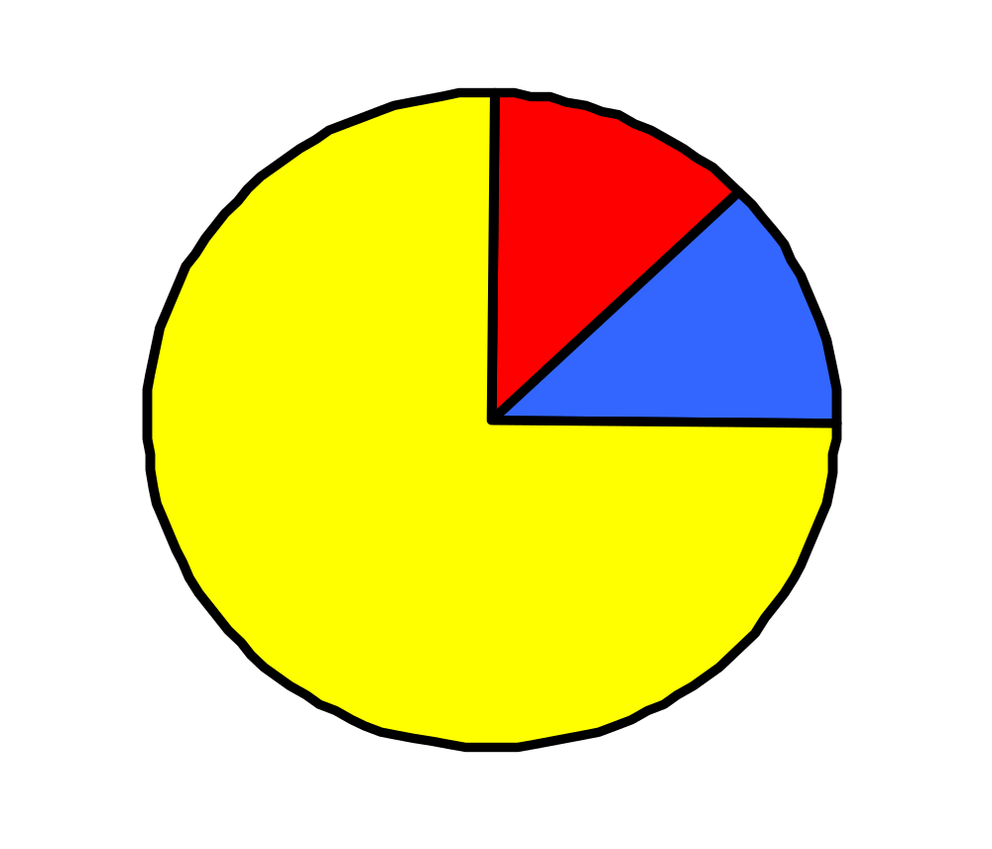
HD7

Slide 6
SAMPLE KEY QUESTIONS
HD7
SUPPORT
CORE
EXTENSION
In my survey there were 8 pupils altogether. How many are shown by the red slice of the pie? The yellow slice?
The blue slice shows 4 people. How many were in my survey altogether?
The red slice represents 3 students. How many …….
There are 10 pupils represented by the blue part of the pie chart.How many people are in the survey altogether?
The yellow sector represents 30 people. How many in the blue sector?
…….

Slide 7
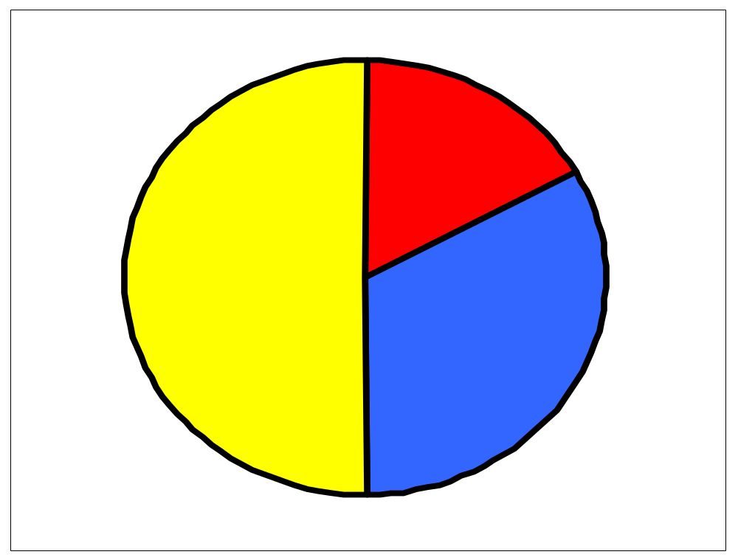
HD8

Slide 8
SAMPLE KEY QUESTIONS
HD8
SUPPORT
CORE
EXTENSION
In my survey there were 18 pupils altogether. How many are shown by the red slice of the pie? The yellow slice?
The blue slice shows 4 people. How many were in my survey altogether?
The red slice represents 3 students. How many …….
There are 16 pupils represented by the blue part of the pie chart.How many people are in the survey altogether?
The yellow sector represents 30 people. How many in the blue sector?
…….

